Slide 1
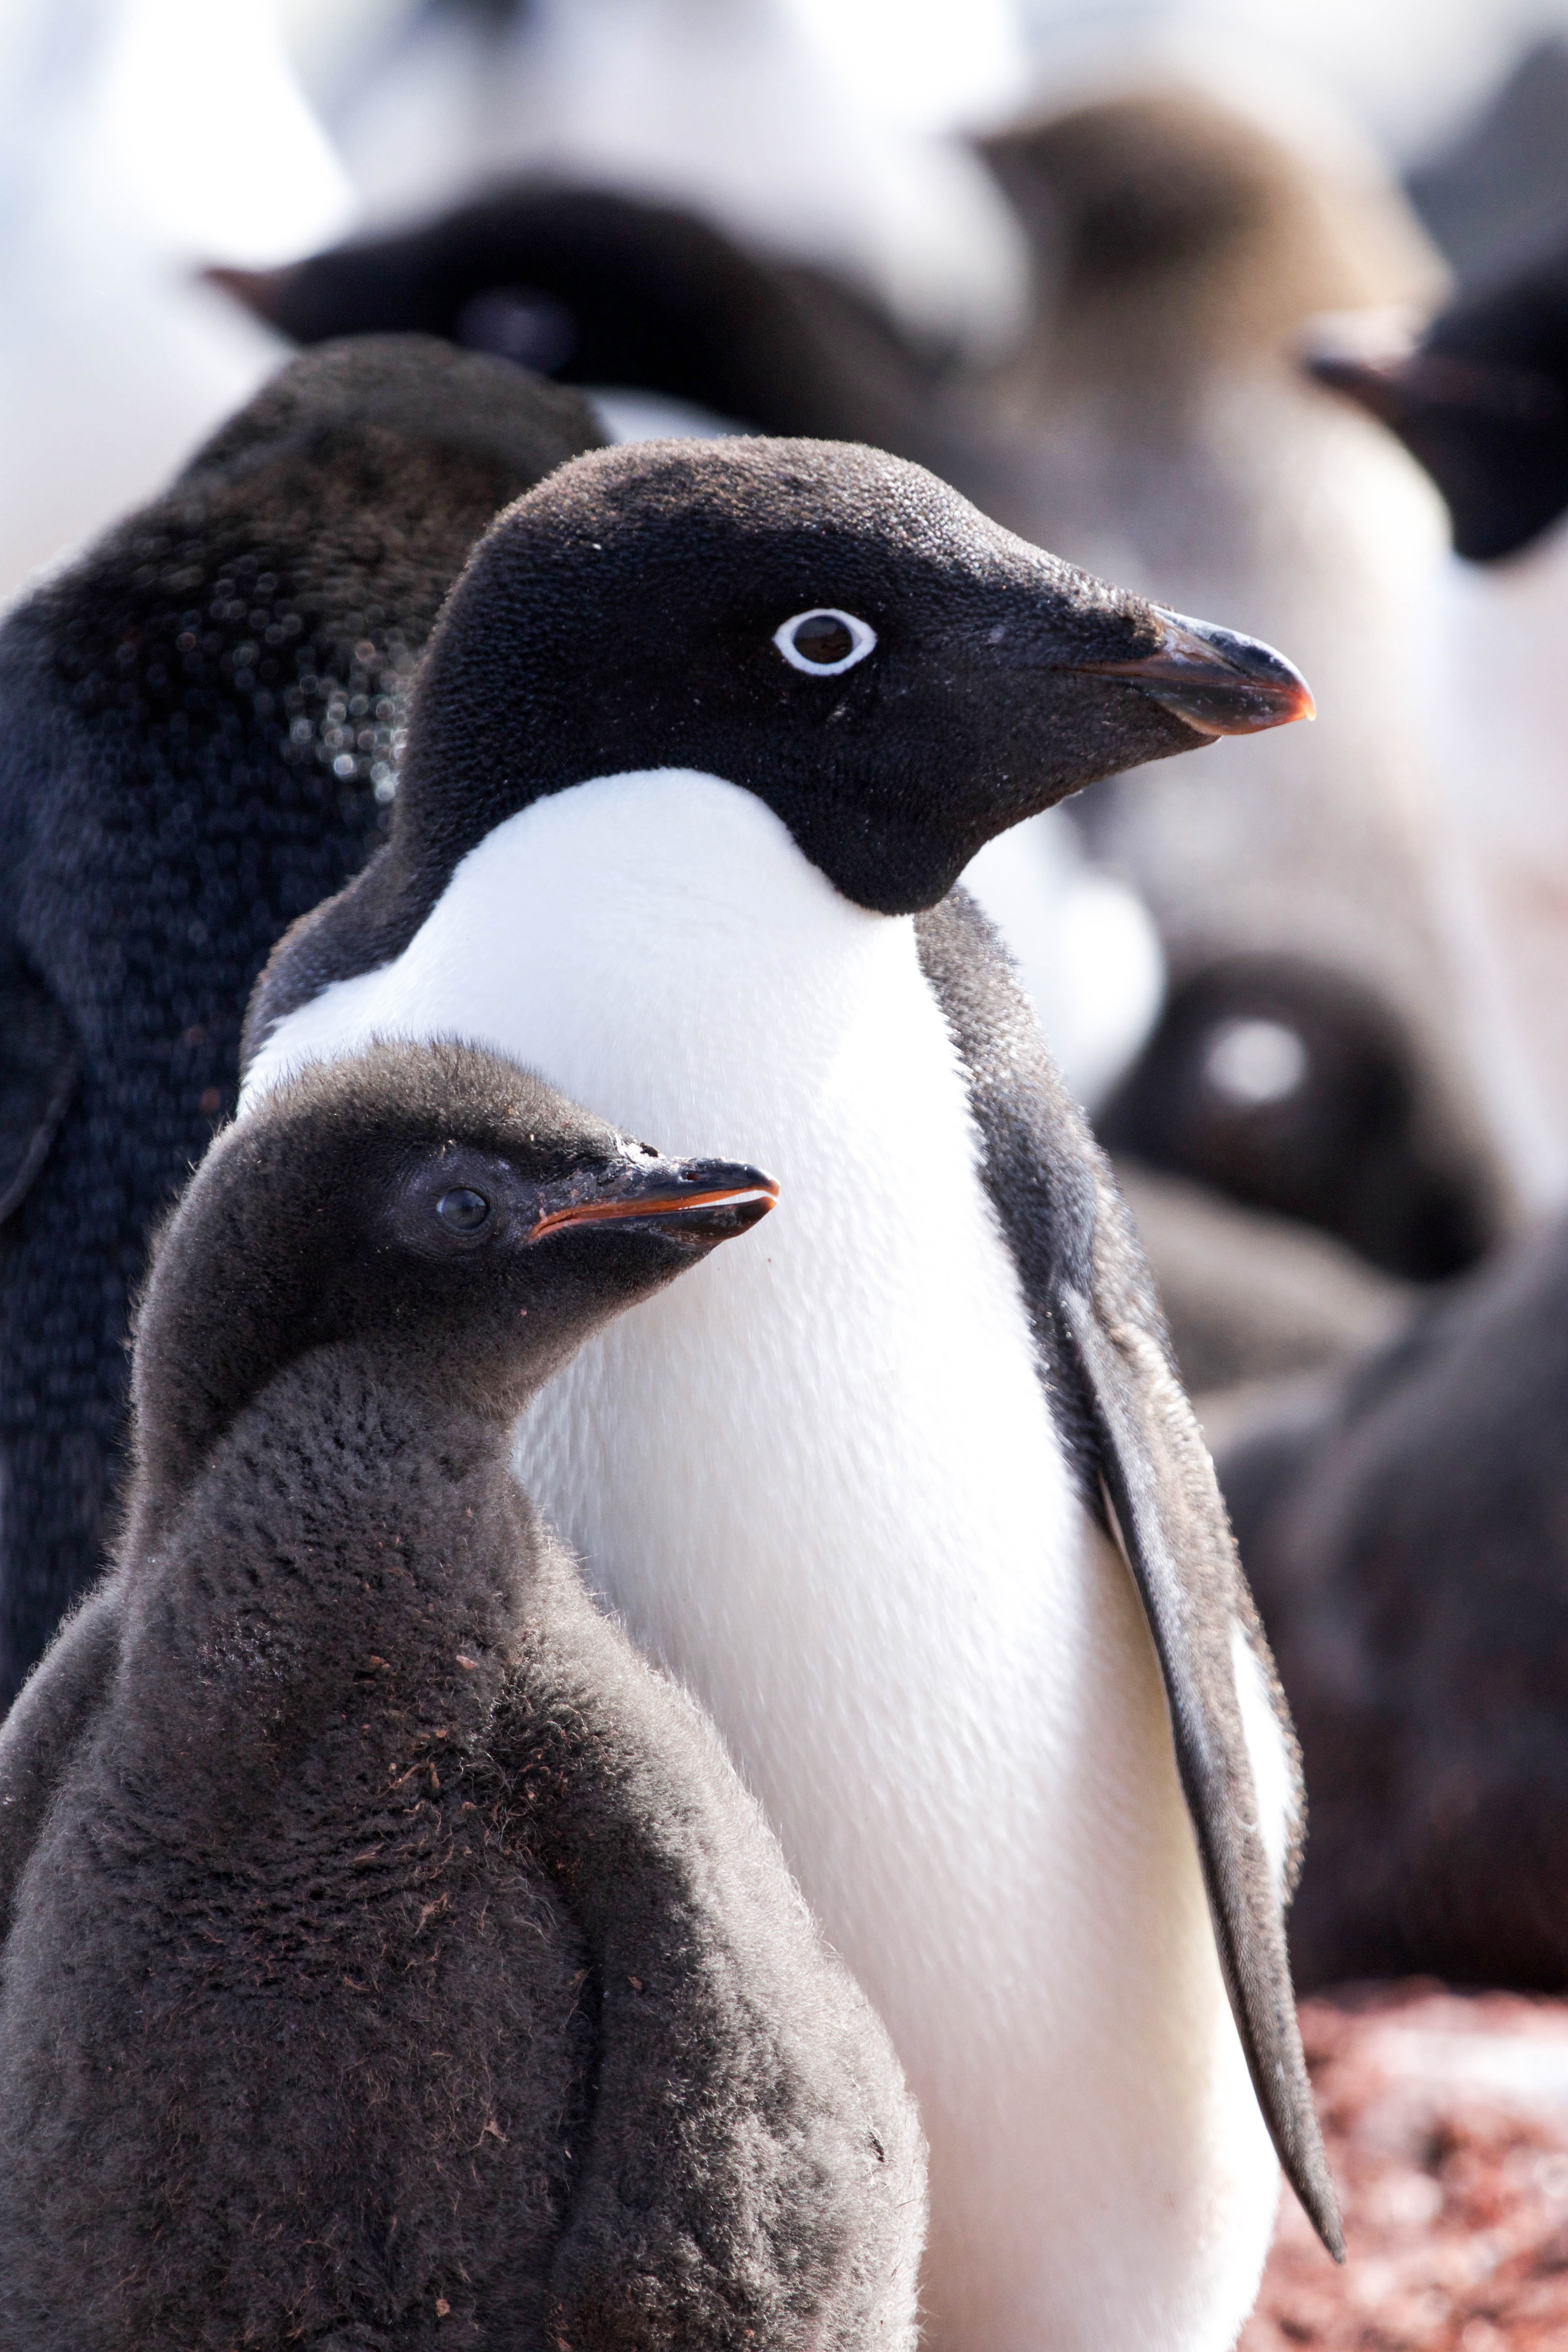
The Case of the Missing Penguins!
MISSING
HAVE YOU SEEN THESE PENGUINS?
Claudia Moncada
Dylan Shaw / Unsplash

Slide 2
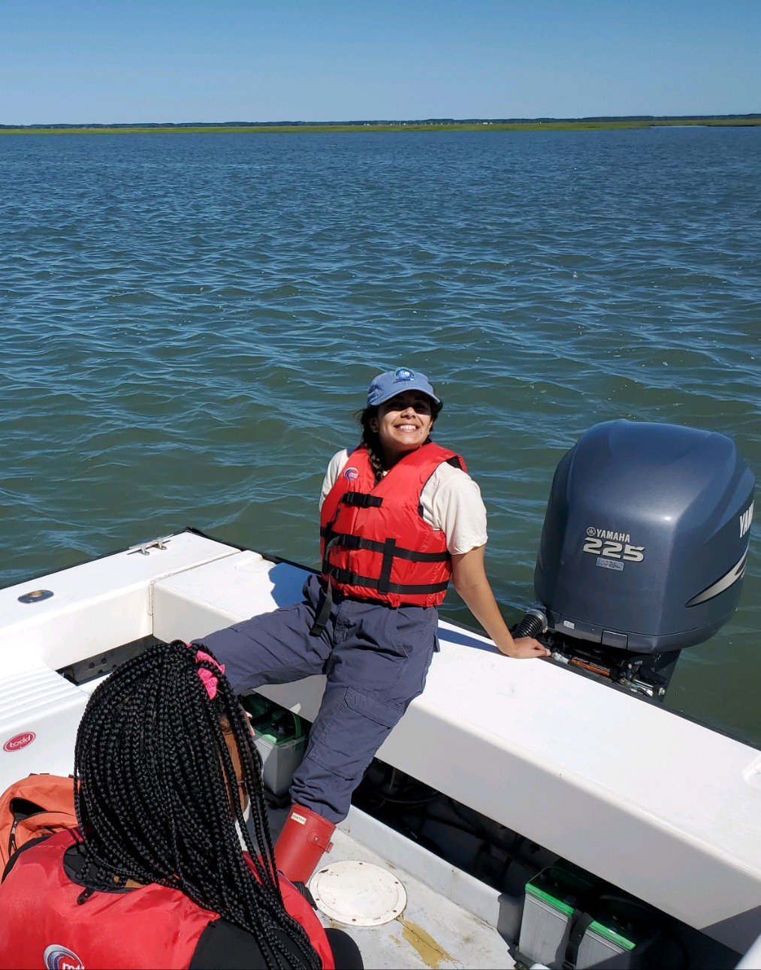
About the author
Hi! My name is Claudia Moncada, and I am a graduate student at the Virginia Institute of Marine Science, William & Mary.
I’m interested in marine science education and bilingual science communication.
I’m so excited that you’ve chosen this lesson!

Slide 3
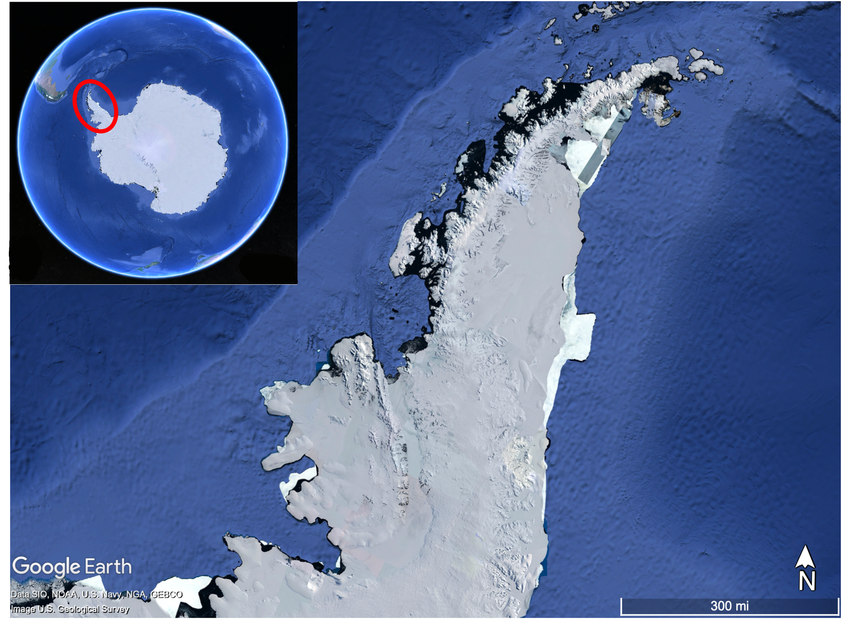
Welcome to Antarctica and the Western Antarctic Peninsula
Quick Facts about the Western Antarctic Peninsula:
This region is super productive: from tiny plankton to penguins and giant whales, there’s plenty of life in this cold place
It’s experiencing warming faster than most other places on Earth due to climate change
Scientists at the Palmer Long-Term Ecological Research Station (LTER) have been researching this area for over 30 years

Slide 4
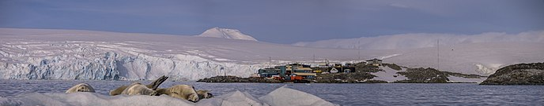
Palmer Long-Term Ecological Research Station
Since the Western Antarctic Peninsula so special, Palmer scientists are studying:
  Physical processes, how they change annually, and their effects on the area’s ecology
  Ecology and populations of marine bacteria, plankton, seabirds, and whales
  Carbon and Nitrogen cycles
  Ecosystem responses to climate migration
  …and so many other things!
Michiel Gitzels / Wikipedia / CC BY-SA3.0

Slide 5
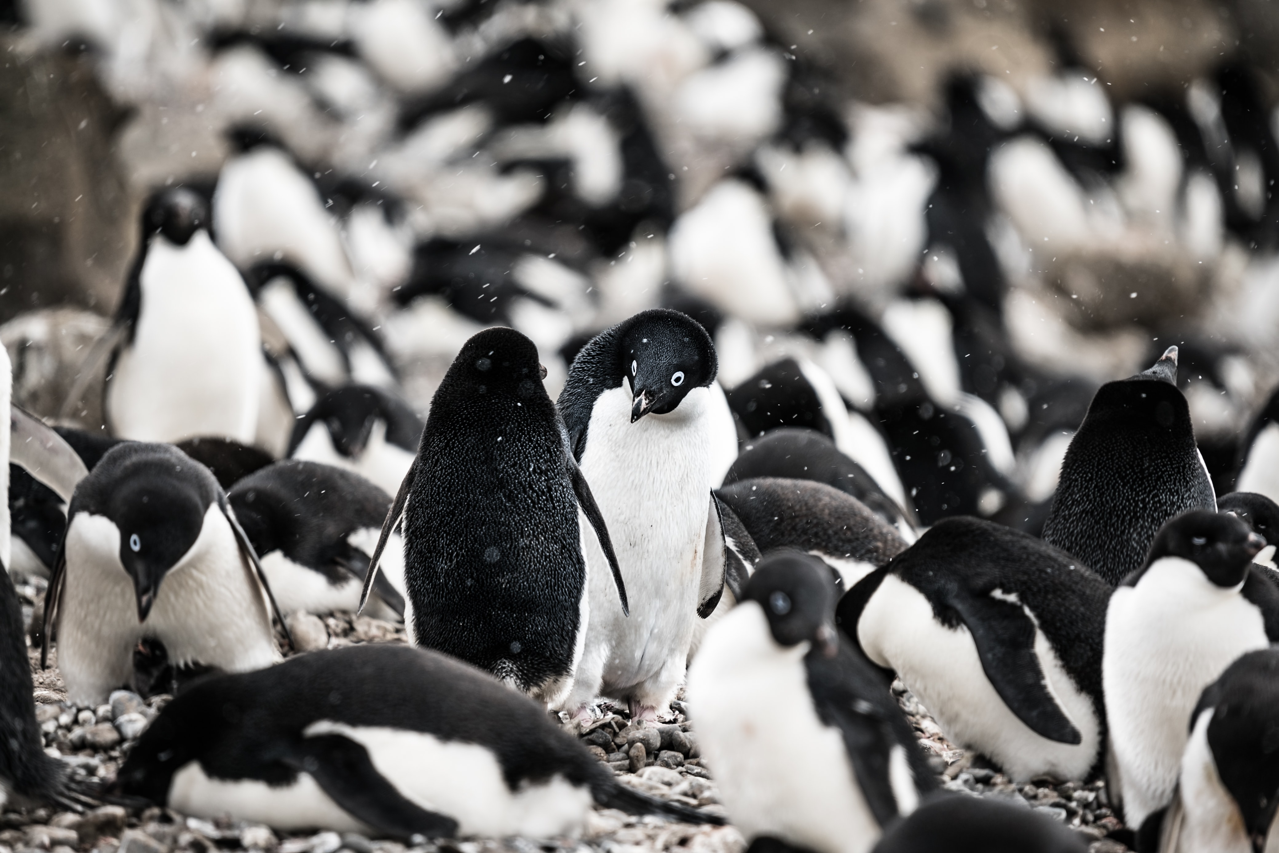
Part 1: The Missing Penguins
Meet the Adélie Penguins
Adélie penguins (Pygoscelis adeliae) are polar species
They are a vital part of the food web in the Western Antarctic Peninsula, eating small fish and krill and serving as food for large predators
They are an ice-obligate species, so they spend a lot of their lives on polar sea ice
While once abundant, their populations have declined approximately 90% since the 1970s!
Hubert Neufeld / Unsplash

Slide 6

Pause! K-W-L Charts
On a blank sheet of paper, create a Know-Want to Know-Learned chart
Take 5 minutes to write down what you Know about climate change and its effects on Earth’s environment, Antarctica, penguins…
Once the timer is up, share with your group and come up with 3 questions for the Want to Know section
KNOW WANT TO KNOW LEARNED
Notes:
Video: Adam Eschborn
https://www.youtube.com/watch?v=_W0bSen8Qjg

Slide 7
Part 1: The Missing Penguins
Your Job
In part 1, you will be:
Collecting data on Adélie penguin breeding pairs from 1991-2020 and plotting your data on a line graph.
Determining if you see any patterns, or trends, in your data.
Figure out if there’s even a question that needs answering!

Slide 8
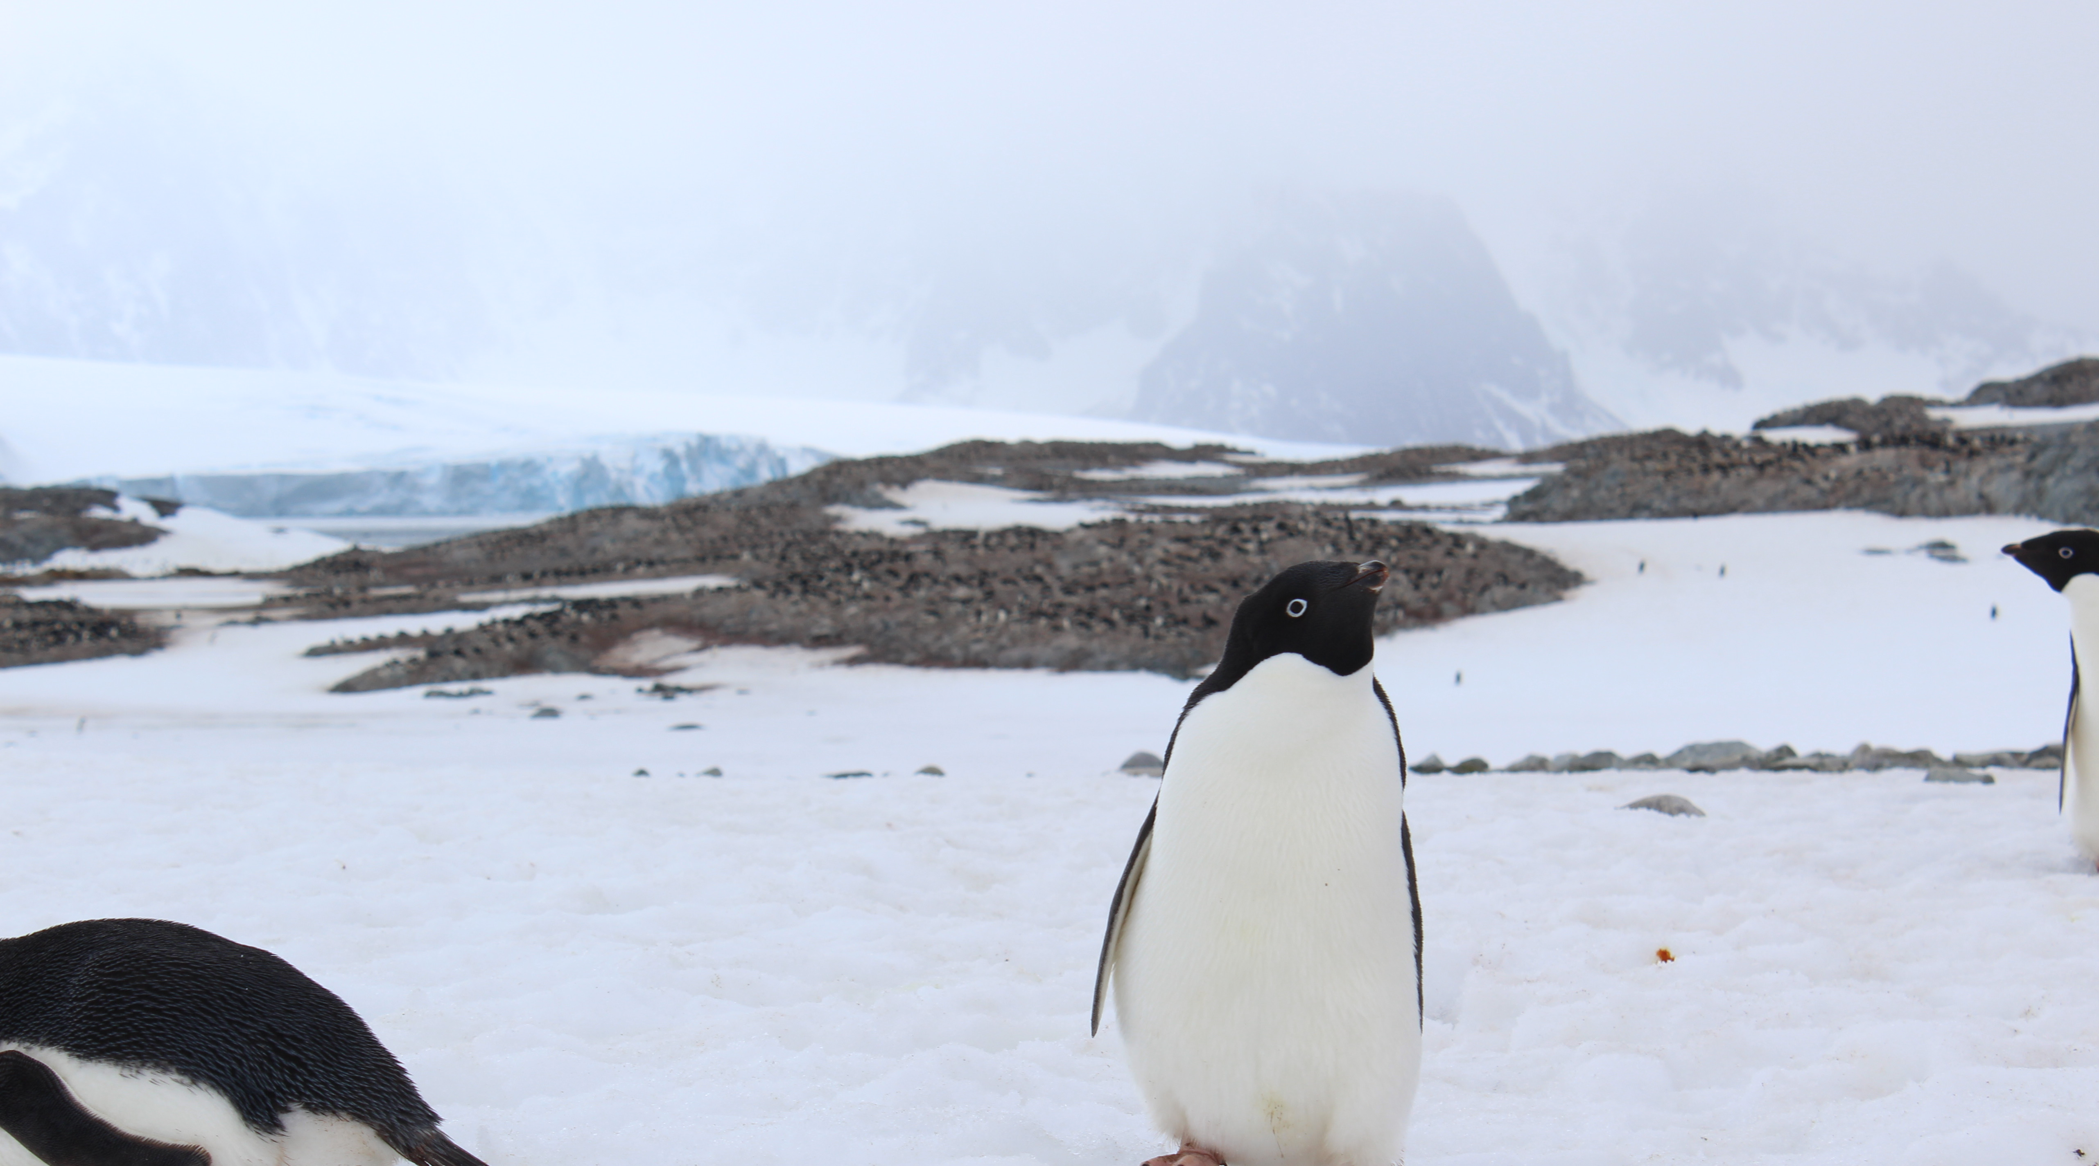
Class Poll: Before we dive any deeper, why do you think Adélie penguin populations are decreasing?
??????????
Maya Thomas

Slide 9
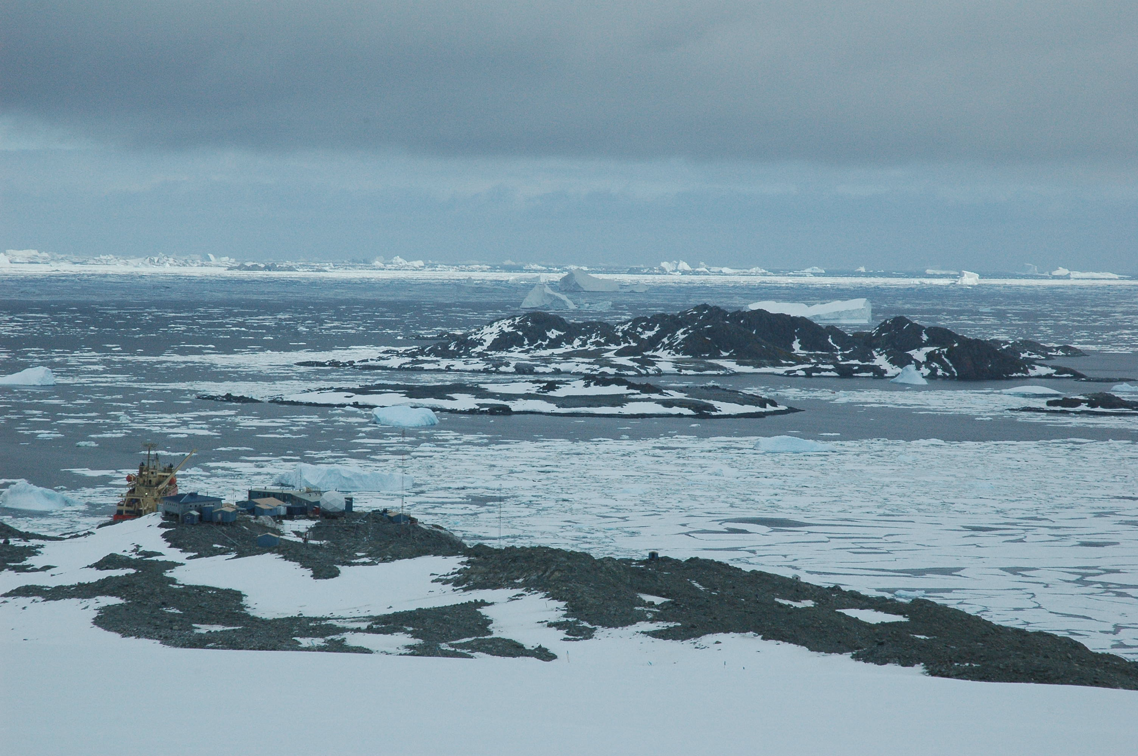
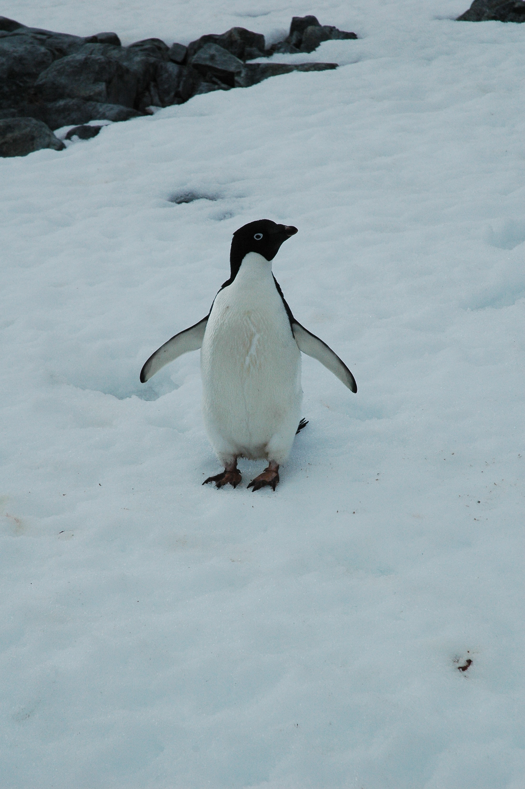
The two main things Palmer scientists are looking at to answer this question are…
Penguin stomach contents and sea ice!
Joe Cope
Joe Cope

Slide 10
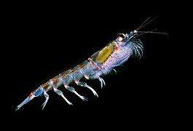
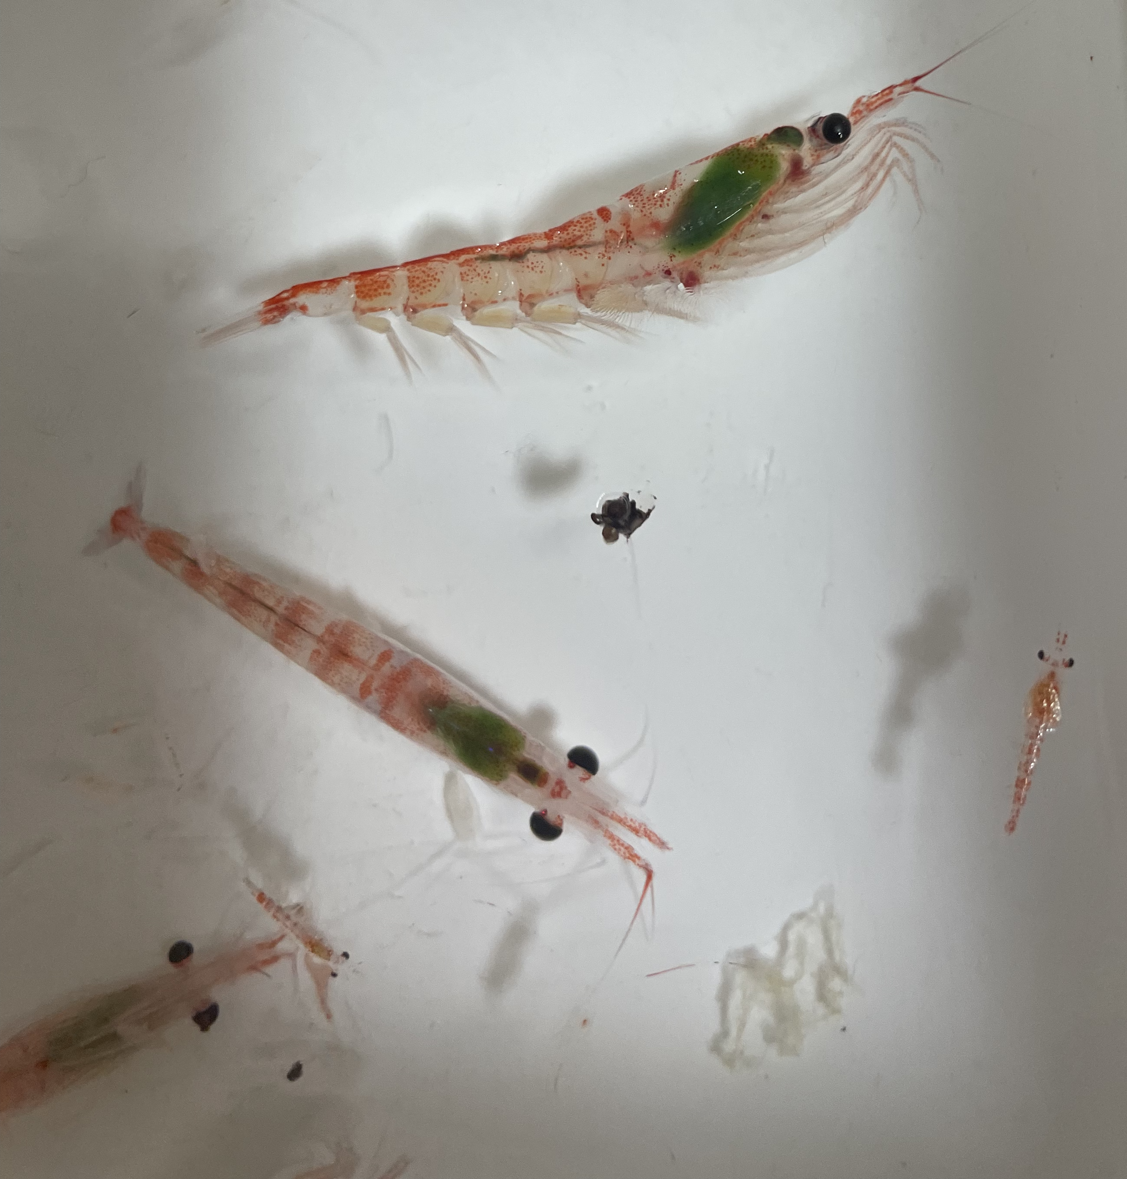
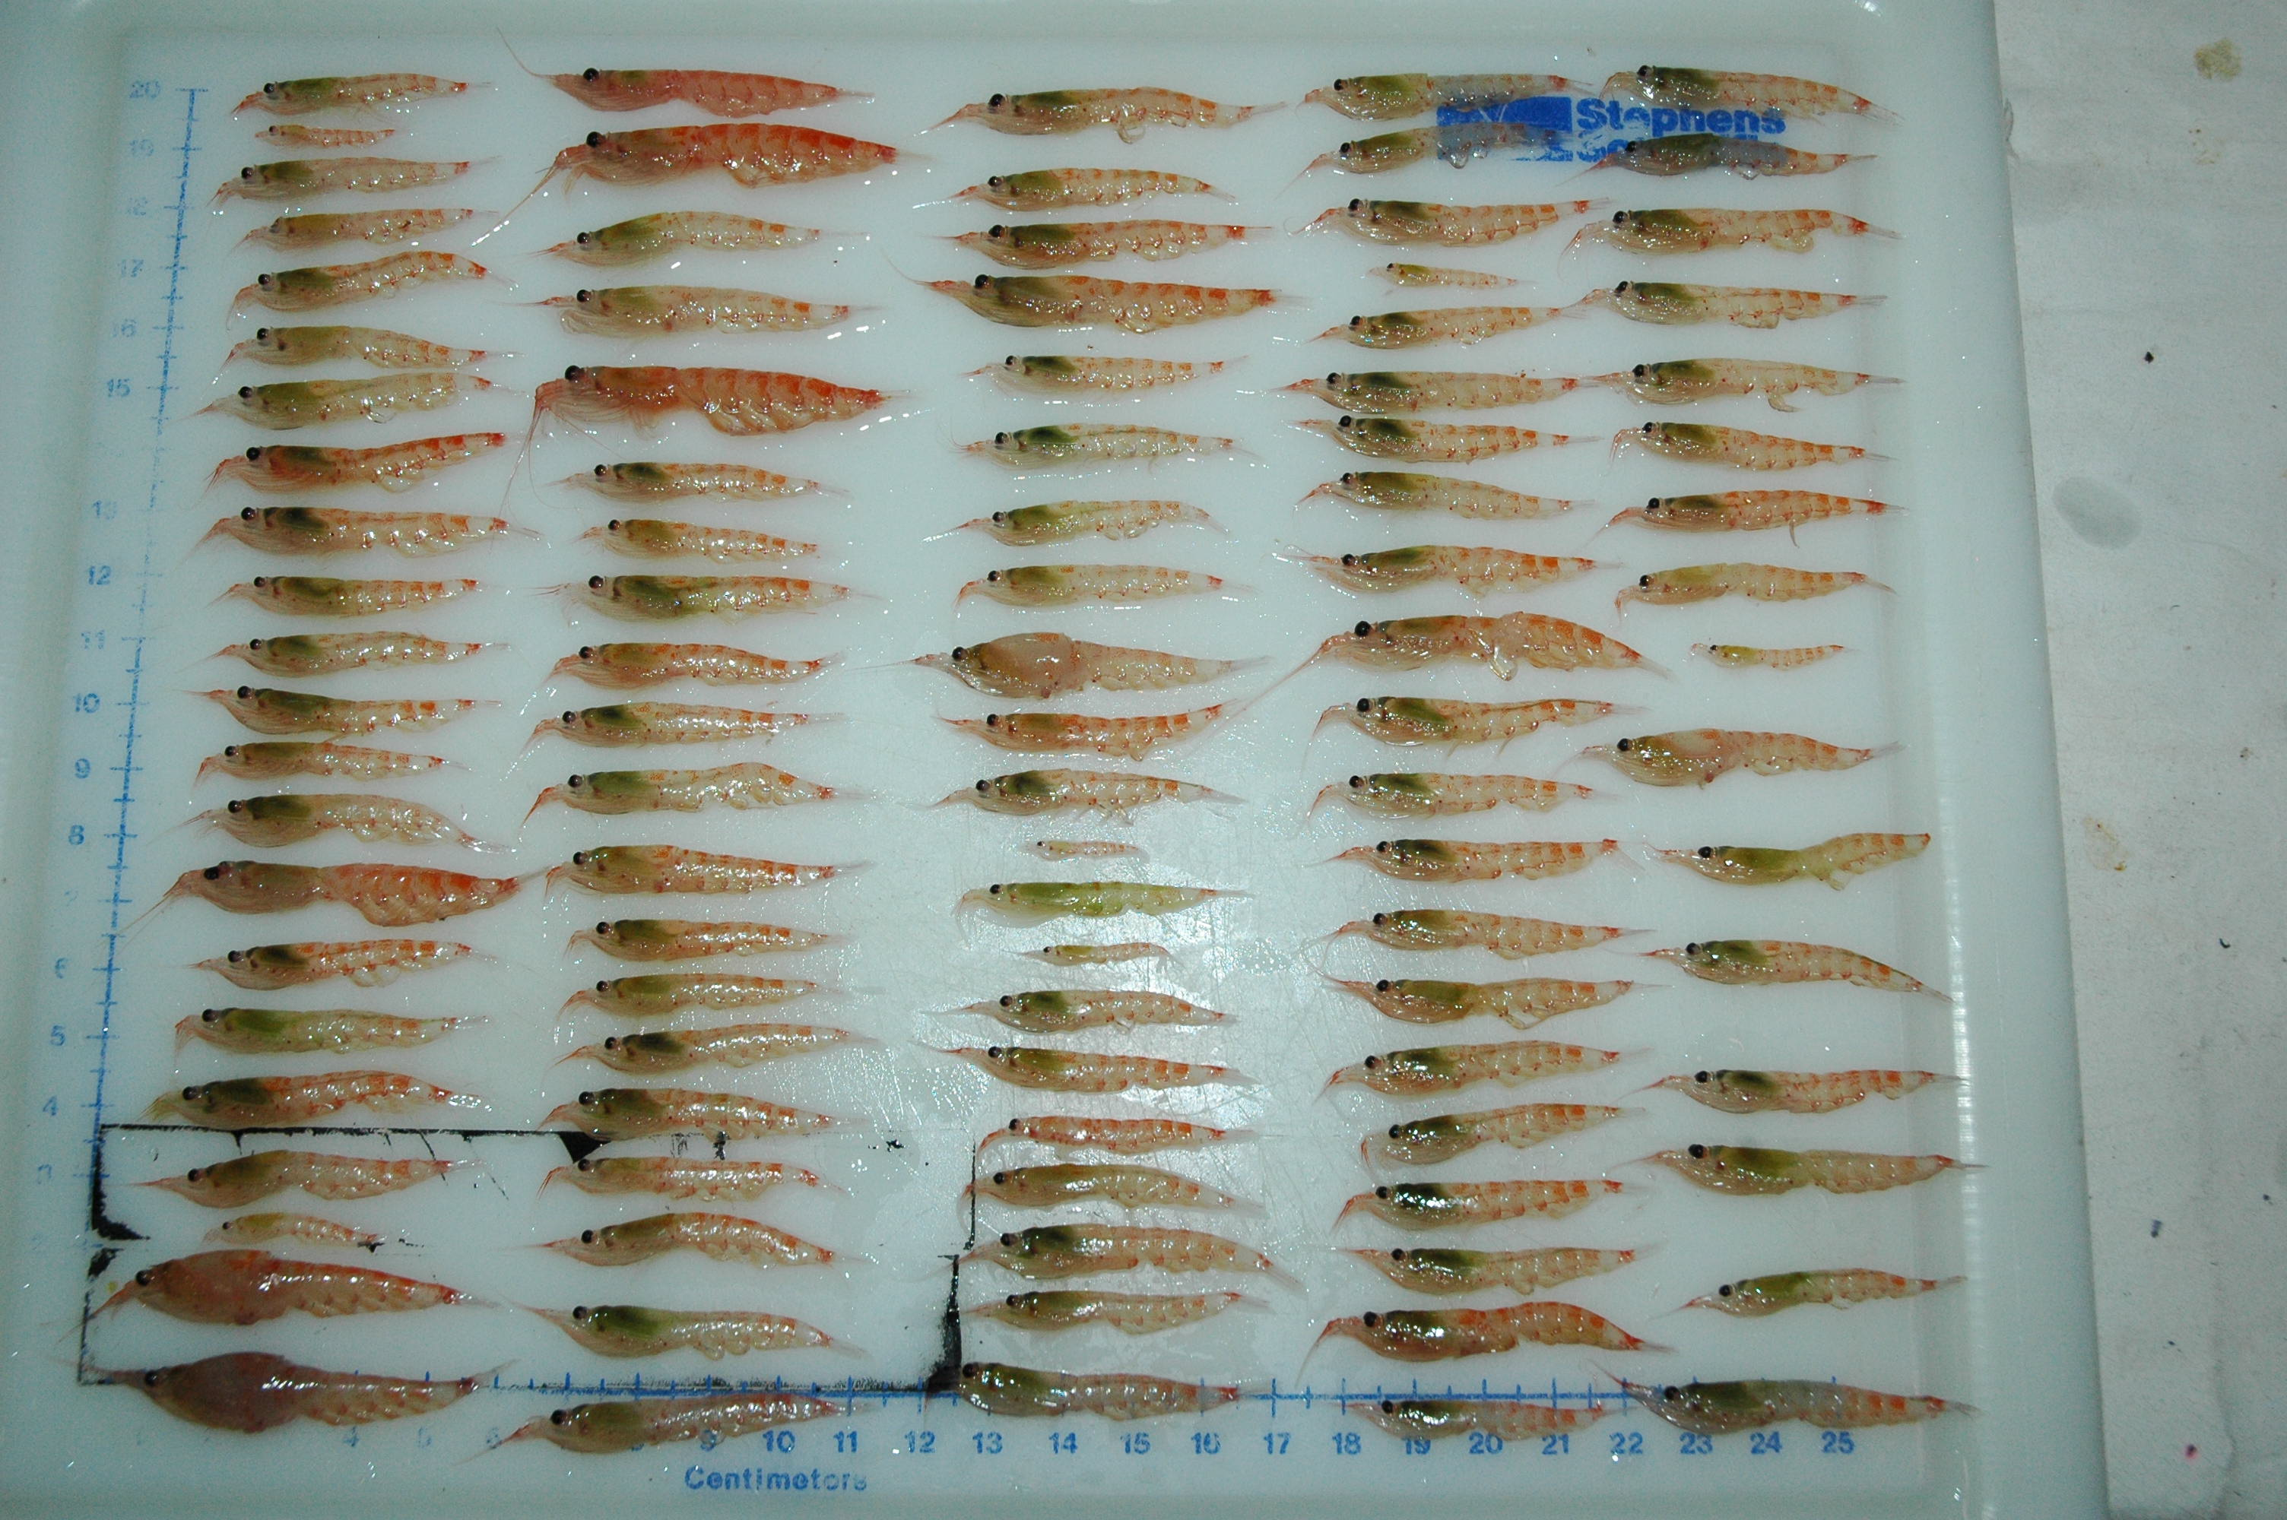
Did you say stomach contents??
Yes! Palmer scientists are investigating whether decreasing krill abundance or a range-shift may be affecting these penguins
Meet the krill these penguins like to eat: Euphausia superba
  These krill like cold, icy waters and are a staple in Adélie penguin diets
Uwe Kils / Wikipedia / CC BY-SA3.0
Maya Thomas
Joe Cope

Slide 11
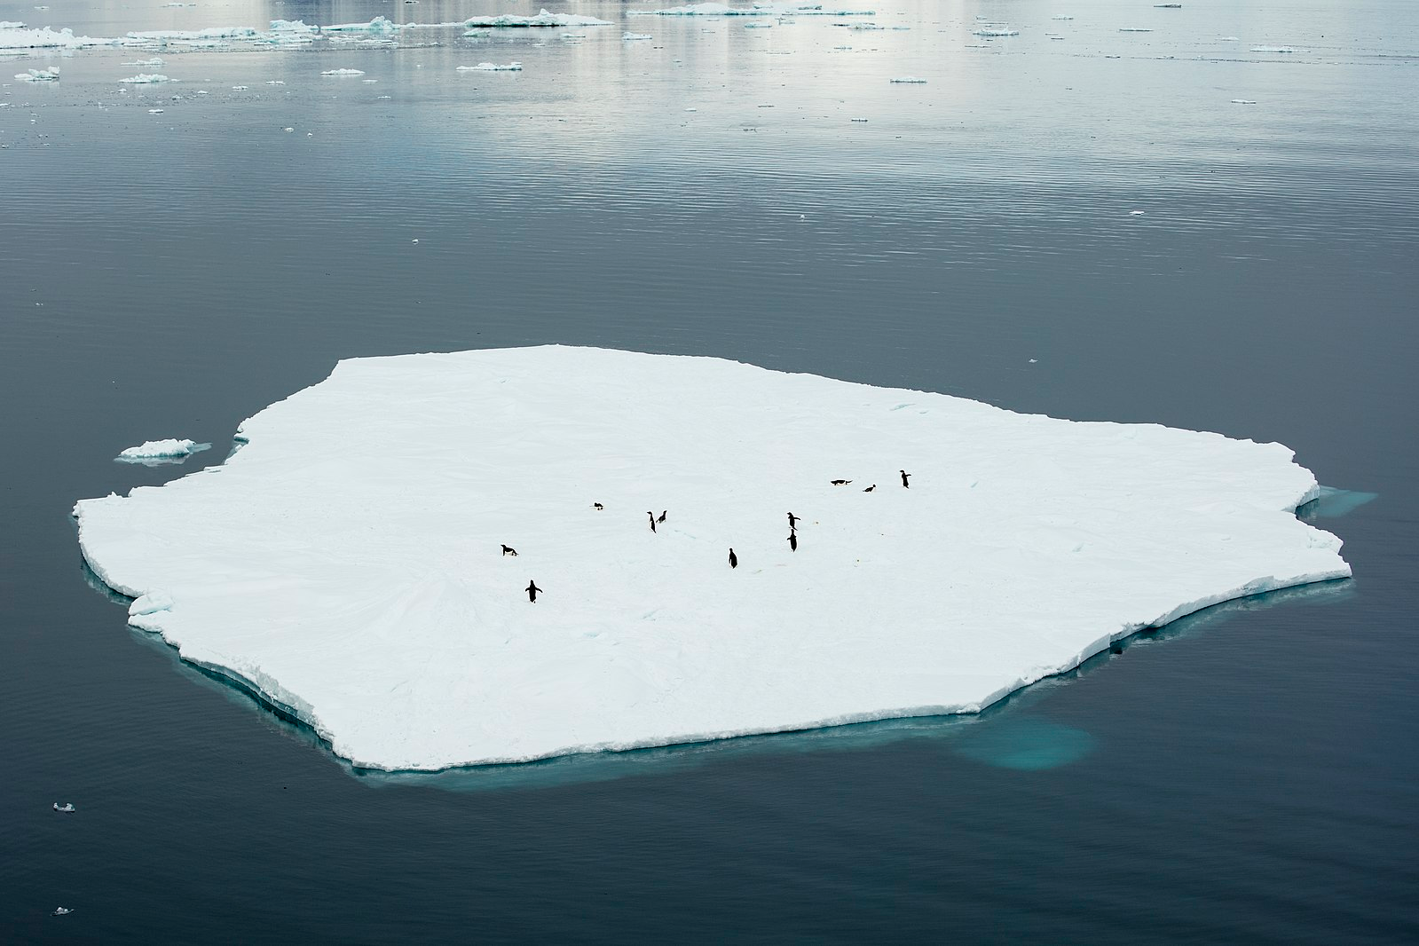
What about sea ice?
Sea ice is frozen seawater that floats on the surface of the ocean
Adélie penguins are an ice-obligate species, which means they spend a large amount of their lives on and around sea ice
Palmer scientists are also investigating whether decreased sea ice coverage due to warming in the Western Antarctic Peninsula is affecting these penguins
Andrew Shiva / Wikipedia / CC BY-SA 4.0

Slide 12
Part 2: Why are they declining?
Investigating some possible explanations
In part 2, you will be:
Collecting and plotting data on the stomach contents of these penguins
Interpreting data on polar sea ice coverage
Looking for possible trends to explain why Adélie penguin populations have decreased so much

Slide 13
Part 2: Why are they declining?
Decoding trends in your data
Did you see a trend in your graph of krill abundance over time in the stomachs of Adélie penguins?
Did you see a trend in the graph showing sea ice coverage over time?
Could either of these variables be the cause of the missing penguins?

Slide 14
Part 3: Drawing your own conclusions
Science isn’t sure… yet!
Palmer scientists are still working hard to determine the cause of the disappearance of Adélie penguins—they don’t have an answer just yet!
Using what you’ve learned about the Western Antarctic Peninsula and Adélie penguins:
  Come up with your own hypothesis to explain the decline in these penguins
  What can you do from home to help these penguins that are so far away?

Slide 15
Wrapping up your K-W-L
Now that we’ve finished the lesson, complete your K-W-L chart by filling in what you’ve Learned
After 5 minutes, share with your group
Notes:
Video: Adam Eschborn
https://www.youtube.com/watch?v=_W0bSen8Qjg

